Slide 1
Logistic Regression
Swarna Chaudhary
Assistant Professor
Swarna.Chaudhary@pilani.bits-pilani.ac.in

Slide 2
Text Book(s)
T1 | Christopher Bishop: Pattern Recognition and Machine Learning, Springer International Edition
T2 | Tom M. Mitchell: Machine Learning, The McGraw-Hill Companies, Inc..
These slides are prepared by the instructor, with grateful acknowledgement of Prof. Andrew Ng, Prof. Tom Mitchell and many others who made their course materials freely available online.

Slide 3
Topics to be covered
Significance of Sigmoid function and finding its derivative
Statistics Foundations – Maximum likelihood estimation
Cross entropy error function for logistic regression and its optimal solution
Decision boundary of logistic regression
Overfitting of logistic regression and counter measures

Slide 4
Linear Regression versus logistic regression
Linear regression is used for predicting the continuous dependent variable using a given set of independent features whereas Logistic Regression is used to predict the categorical.
Linear regression is used to solve regression problems whereas logistic regression is used to solve classification problems

Slide 5
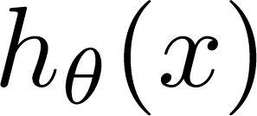
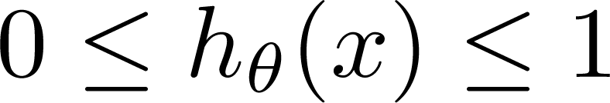
Linear Regression versus Logistic Regression
Classification requires discrete values:
y = 0 or 1
For linear Regression output values:
can be much > 1 or much < 0
Logistic Regression:

Slide 6
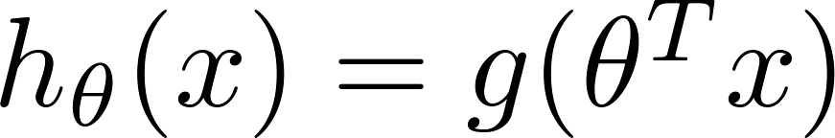
Sigmoid/Logistic Function
Sigmoid/logistic function takes a real value as input and outputs another value between 0 and 1
That framework is called logistic regression
Logistic: A special mathematical sigmoid function it uses
Regression: Combines a weight vector with observations to create an answer

Slide 7
Sigmoid Function
Any function that takes the shape of ‘S’ is called a sigmoid function
Maps input horizon to a bounded, symmetrical output range
Examples:
Logistic Function
Hyperbolic Tangent

Slide 8
Sigmoid Function
Logistic function (a variant of sigmoid) bounds the output between 0 and 1
Conditional probability of a random variable can be expressed as a sigmoid (logistic) function

Slide 10
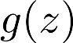
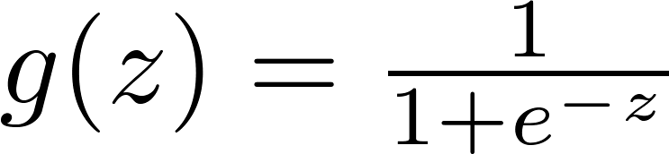
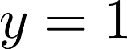
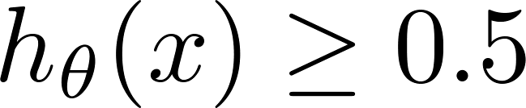
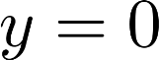
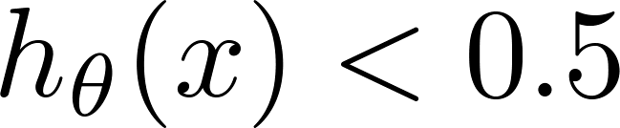
Logistic Regression
1
z
Suppose predict “ “ if
predict “ “ if

Slide 11
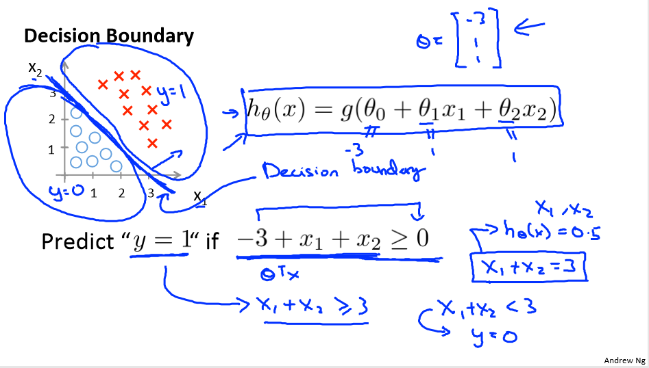

Slide 12
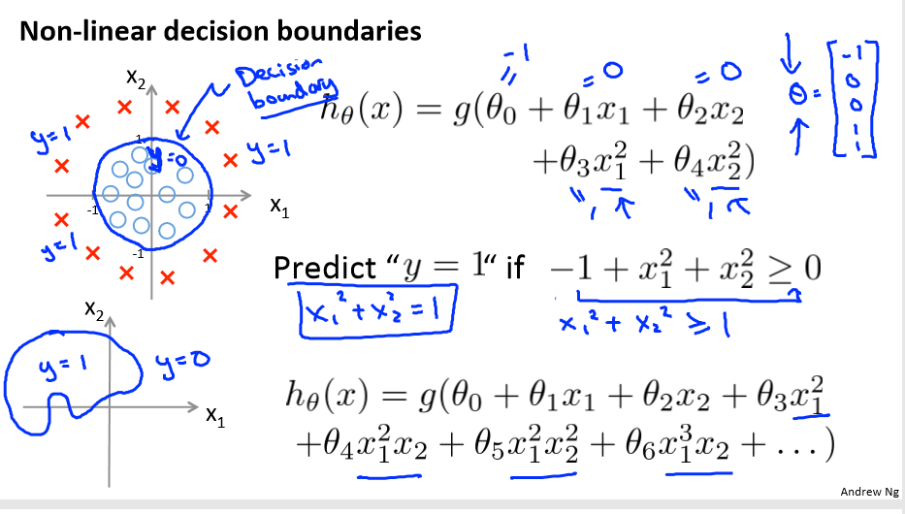

Slide 13
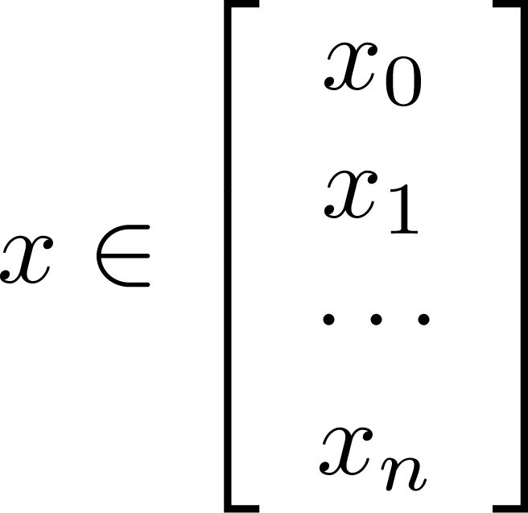
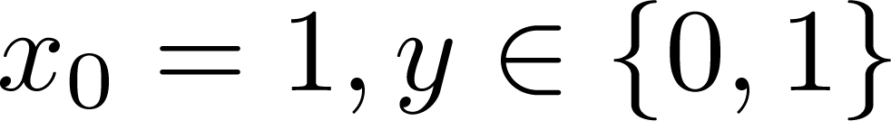
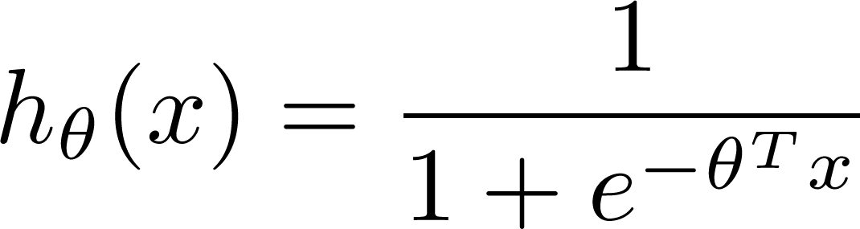

Learning model parameters
Training set:
m examples
How to choose parameters (feature weights) ?
To learn parameters that make predicted value as close to the true value.
We need a cost function and objective to minimize cost function to find optimal values of parameters

Slide 14
Error (Cost) Function
Our prediction function is non-linear (due to sigmoid transform)
Squaring this prediction as we do in MSE results in a non-convex function with many local minima.
If our cost function has many local minimums, gradient descent may not find the optimal global minimum.
So instead of Mean Squared Error, we use a error/ cost function called Cross-Entropy, also known as Log Loss.

Slide 15
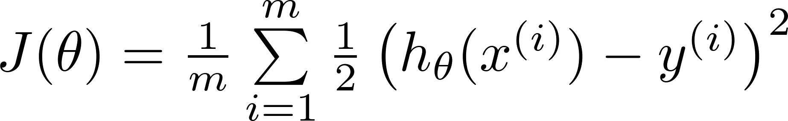
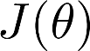
MSE Cost Function
Linear regression:
“non-convex”
“convex”

Slide 16
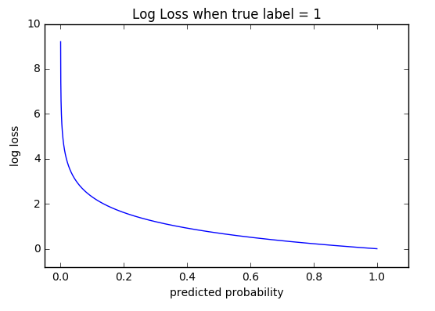
Cross Entropy
Cross-entropy loss, or log loss, measures the performance of a classification model whose output is a probability value between 0 and 1.
Cross-entropy loss increases as the predicted probability diverges from the actual label.
So predicting a probability of .012 when the actual observation label is 1 would be bad and result in a high loss value.
A perfect model would have a log loss of 0.
Cross-entropy loss can be divided into
two separate cost functions:
one for y=1 and
one for y=0.

Slide 17
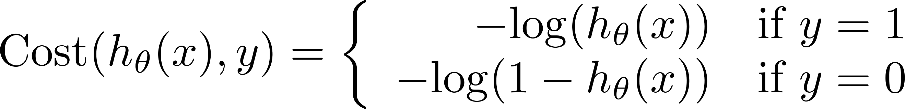
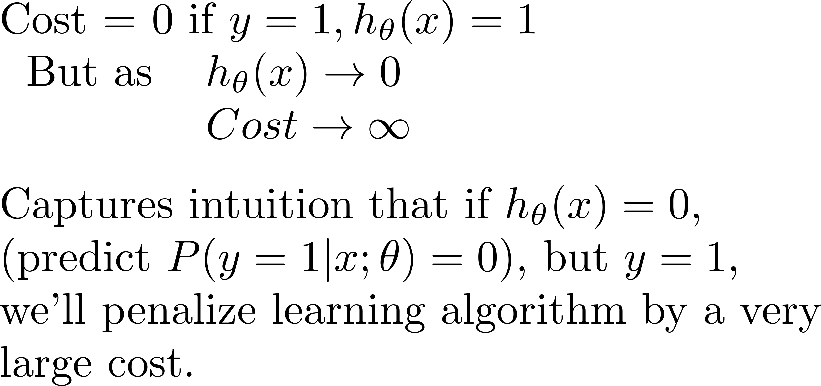
Logistic regression cost function (cross entropy)
If y = 1
Cost
0
1

Slide 18
Logistic regression cost function
If y = 0
Cost=0; If y=0 and h_{Ꝋ}(x)=0
Cost
0
1

Slide 19
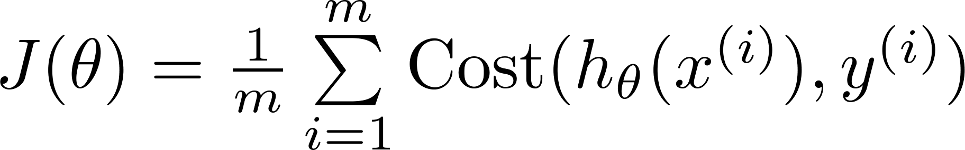

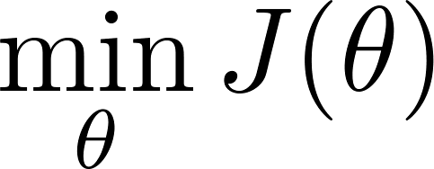

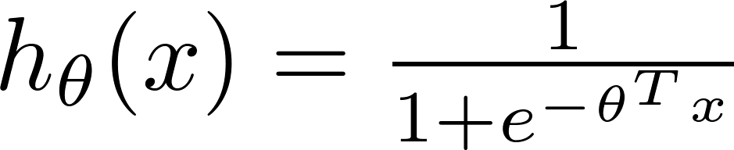
Cost function
To fit parameters : Apply Gradient Descent Algorithm
To make a prediction given new :
Output

Slide 20
Derivative of sigmoid function
Maximum likelihood to determine the parameters of the logistic regression model.
To do this, we shall make use of the derivative of the logistic sigmoid function
Use any algorithm like the gradient descent algorithm to minimize cost function by using derivative
https://towardsdatascience.com/derivative-of-the-sigmoid-function-536880cf918e

Slide 21
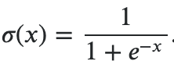
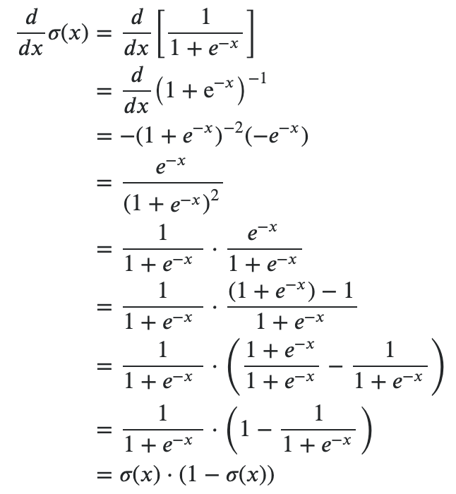
Sigmoid Function
Derivative of sigmoid function is significant in the sense that it represents a bell shaped probability distribution function of the data

Slide 22
Probabilistic Generative Model versus Probabilistic Discriminative Model
Generative:
Discriminative:
x₂
x₂
Decision Boundary
x₁
x₁

Slide 23
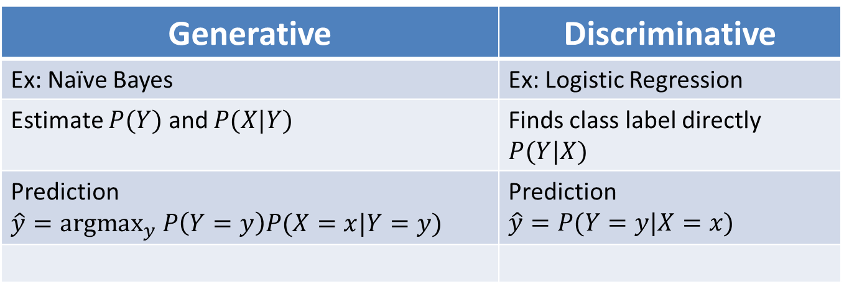
Probabilistic Generative Model versus Probabilistic Discriminative Model
Generative | Discriminative
Ex: Naïve Bayes | Ex: Logistic Regression
Estimate $P(Y)$ and $P(X|Y)$ | Finds class label directly $P(Y|X)$
Prediction $$\hat{y}={argmax}_{y} P\left(Y=y\right)P(X=x|Y=y)$$ | Prediction $$\hat{y}=P(Y=y|X=x)$$

Slide 24
Naïve Bayes versus Logistic Regression
Naïve Bayes are Generative Models which Logistic Regression are Discriminative Models
Naïve Bayes easy to construct
Naïve Bayes better on smaller datasets
Naive Bayes also assumes that the features are conditionally independent. Real data sets are never perfectly independent
When the training size reaches infinity, logistic regression performs better than the generative model Naive Bayes.
Optional reading by Ng and Jordan has proofs and experiments
Logistic regression allows arbitrary features

Slide 25
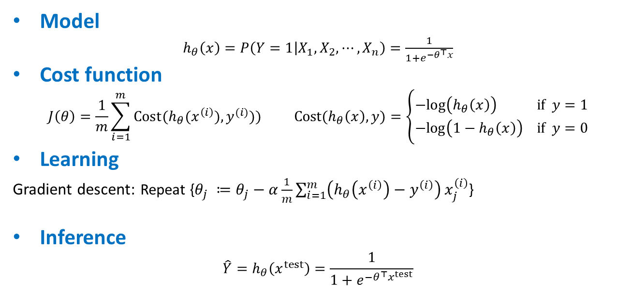
Logistic regression (Classification)
Model
$h_{θ}\left(x\right)=P\left(Y=1 | X_{1},X_{2}, ⋯, X_{n}\right)=\frac{1}{1+e^{−θ^{⊤}x}}$
Cost function
$$J\left(θ\right)=\frac{1}{m}\sum_{i=1}^{m}{Cost(h_{θ}(x^{\left(i\right)}),y^{(i)}))} Cost(h_{θ}\left(x\right),y)=\left\{\begin{aligned}−log\left(h_{θ}\left(x\right)\right) if y=1 \\ −log\left({1−h}_{θ}\left(x\right)\right) if y=0\end{aligned}\right.$$
Learning
Gradient descent: Repeat {$θ_{j} ≔θ_{j}−α\frac{1}{m}\sum_{i=1}^{m}{\left(h_{θ}\left(x^{\left(i\right)}\right)−y^{\left(i\right)}\right)}x_{j}^{\left(i\right)}$}
Inference
$$\hat{Y}=h_{θ}\left(x^{test}\right)=\frac{1}{1+e^{−θ^{⊤}x^{test}}}$$

Slide 26
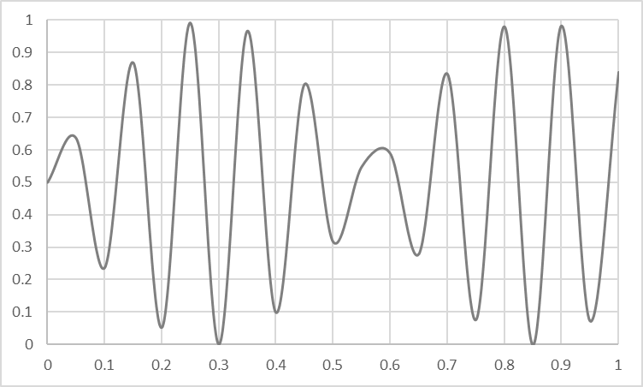
Overfitting vs Underfitting
Overfitting
Underfitting
Fitting the data too well
Features are noisy / uncorrelated to concept
Learning too little of the true concept
Features don’t capture concept
Too much bias in model

Slide 27
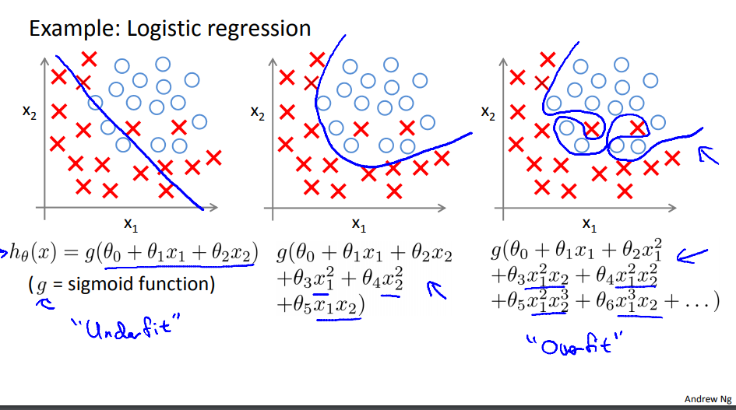
Example

Slide 28
Overfitting
There are two main options to address the issue of overfitting:
1) Reduce the number of features:
Manually select which features to keep.
Use a model selection algorithm
2) Regularization
Keep all the features, but reduce the magnitude of parameters θ
Regularization works well when we have a lot of features and each of which contribute a bit to predicting “y”

Slide 29
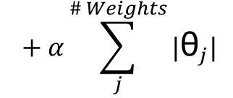
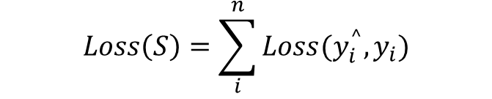
Ways to Control Overfitting
Regularization
$$Loss\left(S\right)=\sum_{i}^{n}{Loss(y_{i}^{^},y_{i})}$$
$$+ α\sum_{j}^{\# Weights}{|{\text{θ}}_{j}|}$$

Slide 30
References
http://www.cs.cmu.edu/~tom/NewChapters.html
http://ai.stanford.edu/~ang/papers/nips01-discriminativegenerative.pdf
https://medium.com/@sangha_deb/naive-bayes-vs-logistic-regression-a319b07a5d4c
https://www.youtube.com/watch?v=-la3q9d7AKQ
Interpretability
https://christophm.github.io/interpretable-ml-book/logistic.html
Regularization
https://www.youtube.com/watch?v=HFkbEOMgq8A&list=PL9jmvZt4yYPp4bCHzOp2gJE0E7OV6MLjW&index=3
Logit
https://www.youtube.com/watch?v=NmjT1_nClzg

Slide 31
Thank You
18 July 2021

